Slide 1

Task |  | R&D Area
1.1 |  | Data Management
1.2 |  | User Interface and Search
1.3 |  | Hardware & Network
1.4 |  | Data Transfer
1.5 |  | Installation (Containerized)
1.6 |  | Authentication & Authorization
1.7 |  | Federation
1.8 |  | Quality Control & Assurance
1.9 |  | Replication
1.10 |  | Distributed Search
1.11 |  | Metrics
1.12 |  | User Notification
1.13 |  | Long-tail Publication
1.14 |  | Distributed Computation
1.15 |  | Data Citation
2.1 |  | Provenance Capture
2.2 |  | Workflow
2.3 |  | Dynamic Resources
2.4 |  | In situ Analysis
2.5 |  | Machine Learning
2.6 |  | UQ
2.7 |  | Analytical Modeling
2.8 |  | Mobile Apps
Current capability status:
 | Usable
 | Prototype
 | Research activity
Diagnostics and Metrics
Zeshawn Shaheen
Lawrence Livermore National Laboratory
2017 Triennial Project Review, Potomac, MD
June 8 – 9, 2017
This work was performed under the auspices of the U.S. Department of Energy by Lawrence Livermore National Laboratory under Contract DEAC52-07NA27344.

Slide 2




Beneficiaries
Notes:
* All groups can benefit from each other

Slide 3
Contents
Introduction [1.14d]
Problems solved [1.14d]
Design and architecture [1.14d]
Uses [1.14d]
Proposed work [2.5a]

Slide 4

Introduction [1.14d]
Framework for managing and modularizing tasks related to diagnostics
Handle user input
Computing metrics
Provenance capture
Distributed job runs and more
Basic structure but allows for independence (no dependencies)
Optional support for commonly used tasks
Graphing with Visualization Control System (VCS)
Viewing output with built-in viewer
Metric calculations with CDAT( GenUtil, CdUtil)

Slide 5
Problems solved [1.14d]
Scientific code is complex and in many cases has a short life
Scientists do not have the urgency to implement good software engineering principles
Should focus on science domain work, not output viewing, parallelism, etc.
Also provides a framework for diagnostics and algorithms to be shared
Done through parameters
Ex: ACME Diagnostics:
Diagnostics added during runtime
Select model/obs data, regions, seasons, variables, more
Add derived variables
Notes:
Separation of concerns, other software design methodology
Provides a framework for … : through the use of standardized interfaces

Slide 6
Design and architecture [1.14d] (1)
Driver
Metrics
Cacheable and sharable
I/O
Single interface, multiple outputs
User Code
Inputs
Parser
Command line parser to create Parameters
Parameters
Cleans and handles user input
Results
Viewer
View images, data files, etc.
Provenance
Metadata to recreate a run
Notes:
In a given project, such as PMP, the user can switch out the driver. So same parameters, but different drivers.
In the ACME Diagnostics package, similar parameter keywords are used, so user can use PMP parameters on ACME Diagnostics

Slide 7
Design and architecture [1.14d] (2)
Inputs
Parameters object:
Used as input, created from a Python script
Encapsulates sanitization of user input
Parser object: creates Parameters object from the command line
Takes raw file: diags_package.py -p myparams.py
Individual parameters are command line arguments, ex: diags_package.py -p myparams.py –-region ANN
Example parameters script:
variables = [‘T’, ‘PRECT’]
regions = [‘global’]
seasons = [‘ANN’, ‘DJF’]

Slide 8
Design and architecture [1.14d] (3)
Driver
Metrics:
Cacheable
Single interface to work with Fortran, C, Python code
Works with CDP Provenance
ESGF Compute API metrics as well
Library of metrics
I/O:
Handles input/output with JSON, NetCDF, HDF file formats

Slide 9
Design and architecture [1.14d] (4)
Viewer:
Easily create an interactive, sharable HTML page
Provenance:
Create a backup of the parameters script
Log of output, utils for data validation (hashing, etc.)
Main script (driver), designed for a single run
Input: Parameters object
Do calculations using metrics, I/O for data files
Results: View results with CDP Viewer, provenance capture through CDP Provenance.
Results

Slide 10
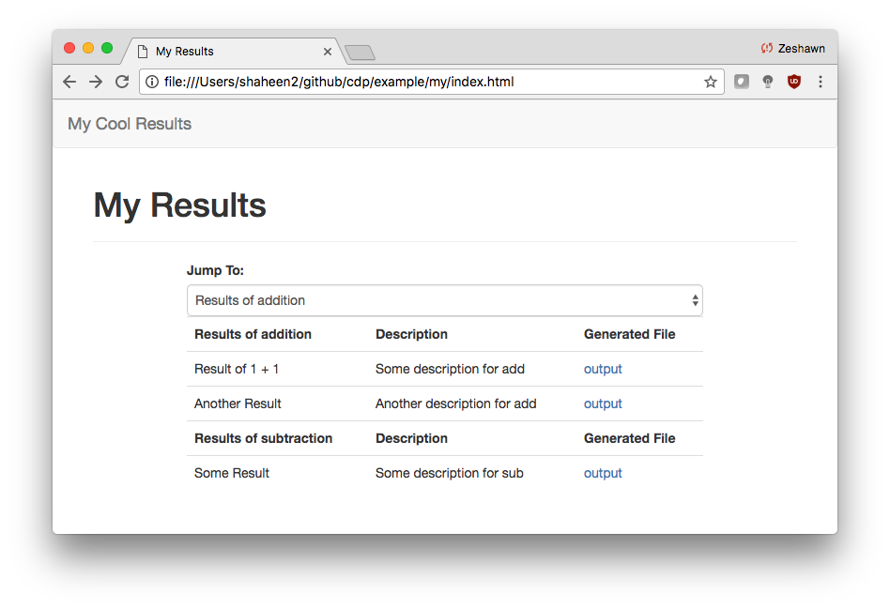
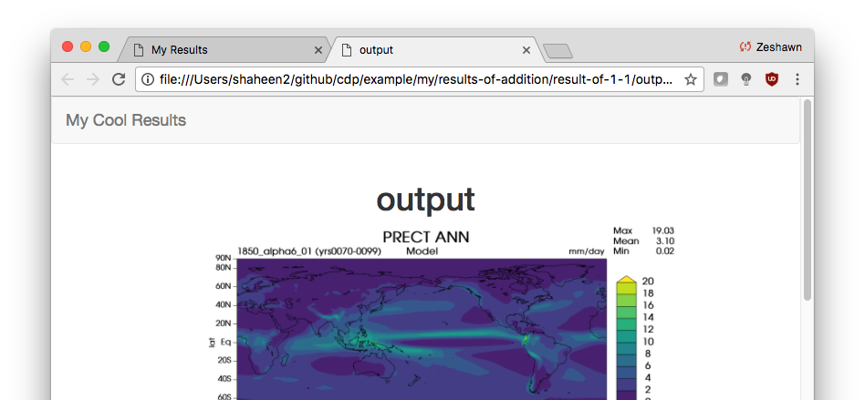
Design and architecture [1.14d] (5)
Only 12 lines of code
from cdp.cdp_viewer import OutputViewer
viewer = OutputViewer(index_name='My Cool Results')
viewer.add_page("My Results", ['Description', 'Generated File'])
viewer.add_group('Results of addition')
viewer.add_row('Result of 1 + 1') viewer.add_col('Some description for add')
viewer.add_col('output.png', is_file=True)
viewer.add_row('Another Result')
viewer.add_col('Another description for add')
viewer.add_col('output.png', is_file=True)
viewer.add_group('Results of subtraction')
viewer.add_row('Some Result') viewer.add_col('Some description for sub') viewer.add_col('output.png', is_file=True)
viewer.generate_viewer()

Slide 11
Design and architecture [1.14d] (6)
{
"run_id1": {
"var": "T",
"seasons": ["ANN", "SON"]
},
"run_id2": {
"var": "PRECT",
"seasons": ["JJA",]
}
}
Data parallelism
User can submit multiple runs:
diags_package.py -p myparams1.py myparams2.py
diags_package.py -p myparams.json
Compose parameters:
diags_package.py -p myparams.py –d myparams.json
Middleware: Runs can be ran distributed on a cluster using Distributed Resource Management Application API (DRMAA)
DRMAA: interface for workload managers (SLURM, HTCondor, Torque/PBS, more)
Distributed transparency: interface to run is same on single machine and cluster
CDP Command-Line Interface (CLI)
Tool for viewing status of, restarting, killing jobs
Optional, workload manager works as well

Slide 12


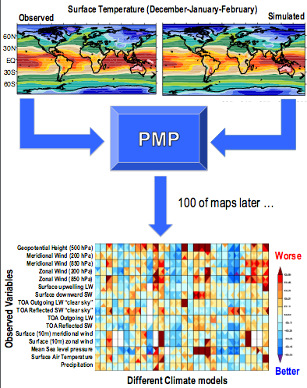
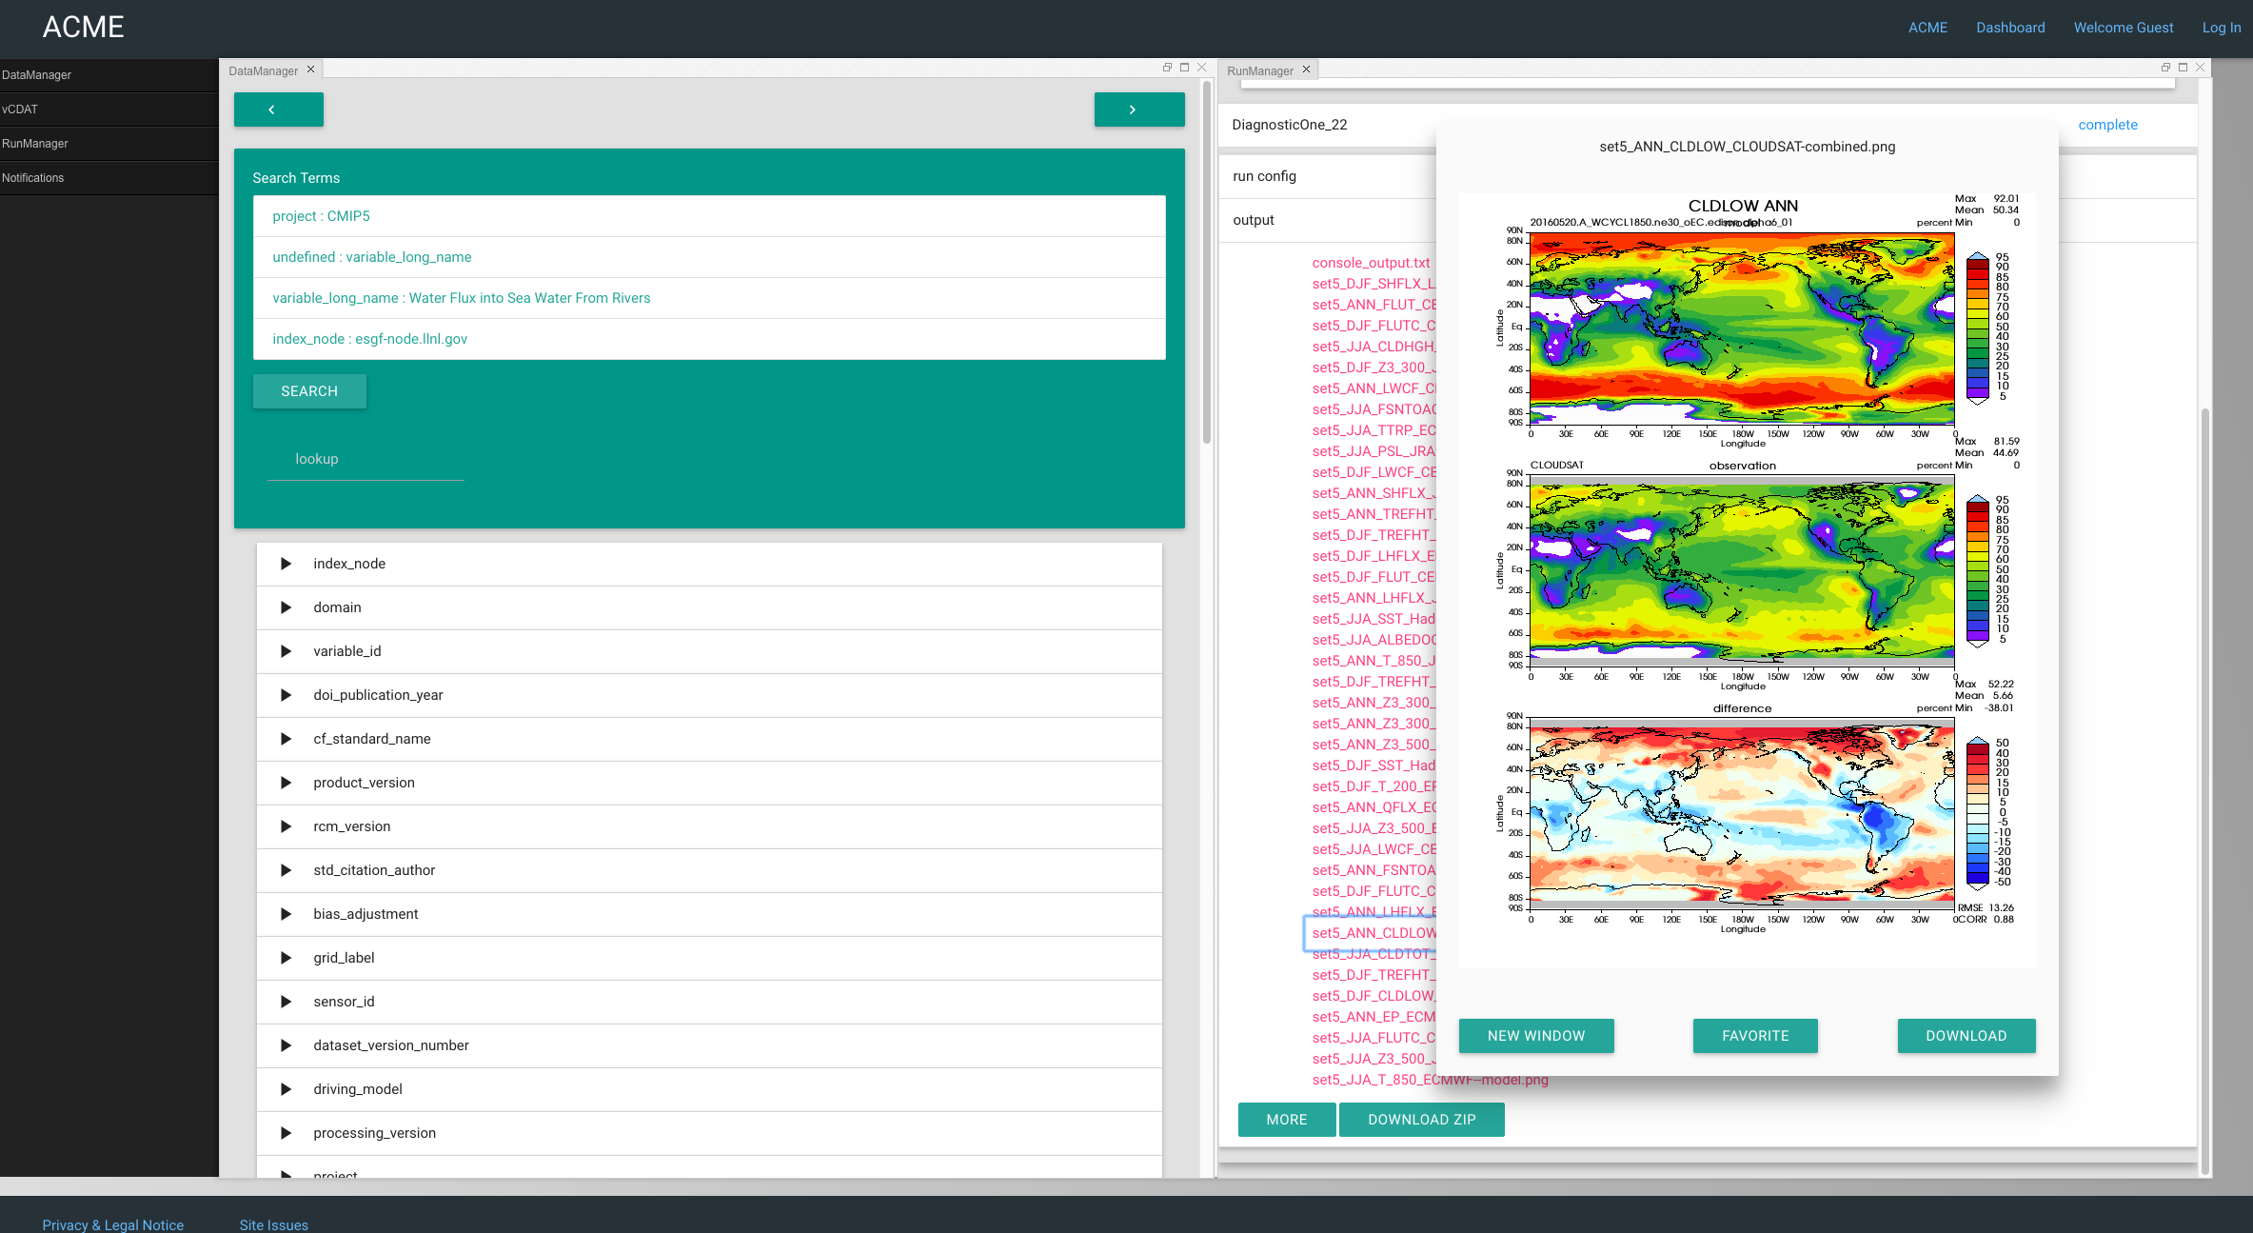
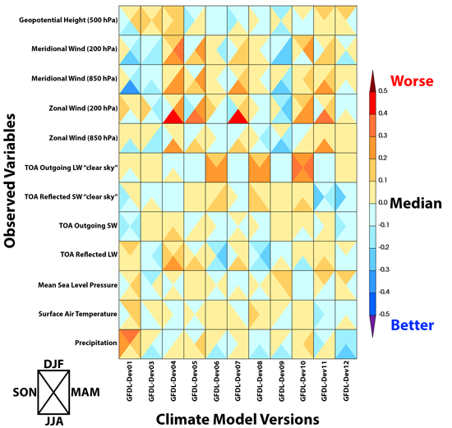
Uses [1.14d]
PCMDI Metrics Package:
Completed January 2017
Need to add new features
ACME Diagnostics Package
In progress, ETA end of 2017
Replacement for AMWG Diagnostics
ARM Diagnostics
Atmospheric diagnostics
Package of climate model evaluation metrics that is developed for CMIP
Diagnostics output of the ACME model run, using the built-in viewer to view results
ARM Diagnostics output.

Slide 13
Proposed work [1.14d]
Jupyter Notebook: Run diags server-side via tutorial
Implement provenance and I/O
Implement distributed computation
PyDRMAA for scheduling
RabbitMQ for task queue, Redis for results backend
Interface for plotting reference, test, and diff data
plot(reference, test, difference)
Finish implementing ACME Diagnostics, ARM Diagnostics, and expand on PCMDI Metrics Package

